Slide 1
Financial Modeling --Machine Learning HW1
Carter (Shaojie) Zhang

Slide 2
Problem 1
You will be issued a personal number between 1 and 45 (your number in the class list).
Generate a new sample of the same size as the training set using the random number generator seed =your personal number +100.
Do the prediction with analysis (accuracy and confusion matrix).

Slide 3
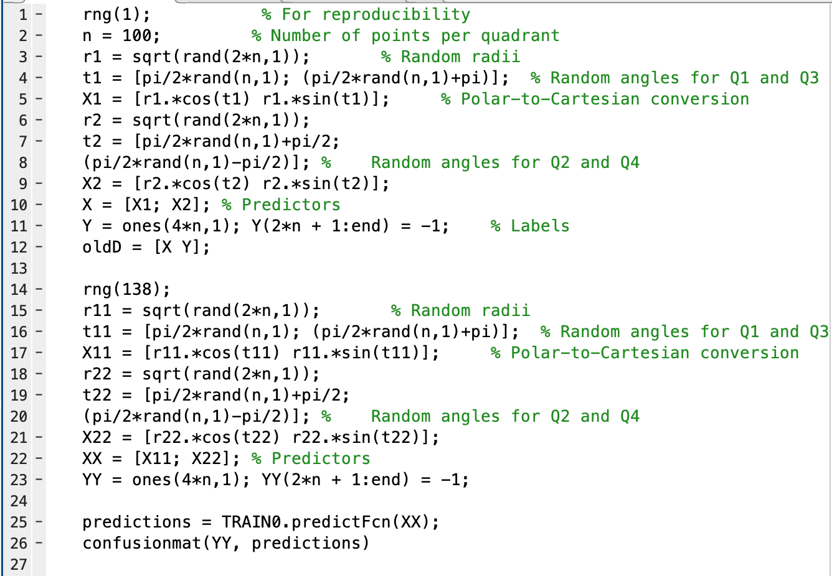
Given a number of 38

Slide 4
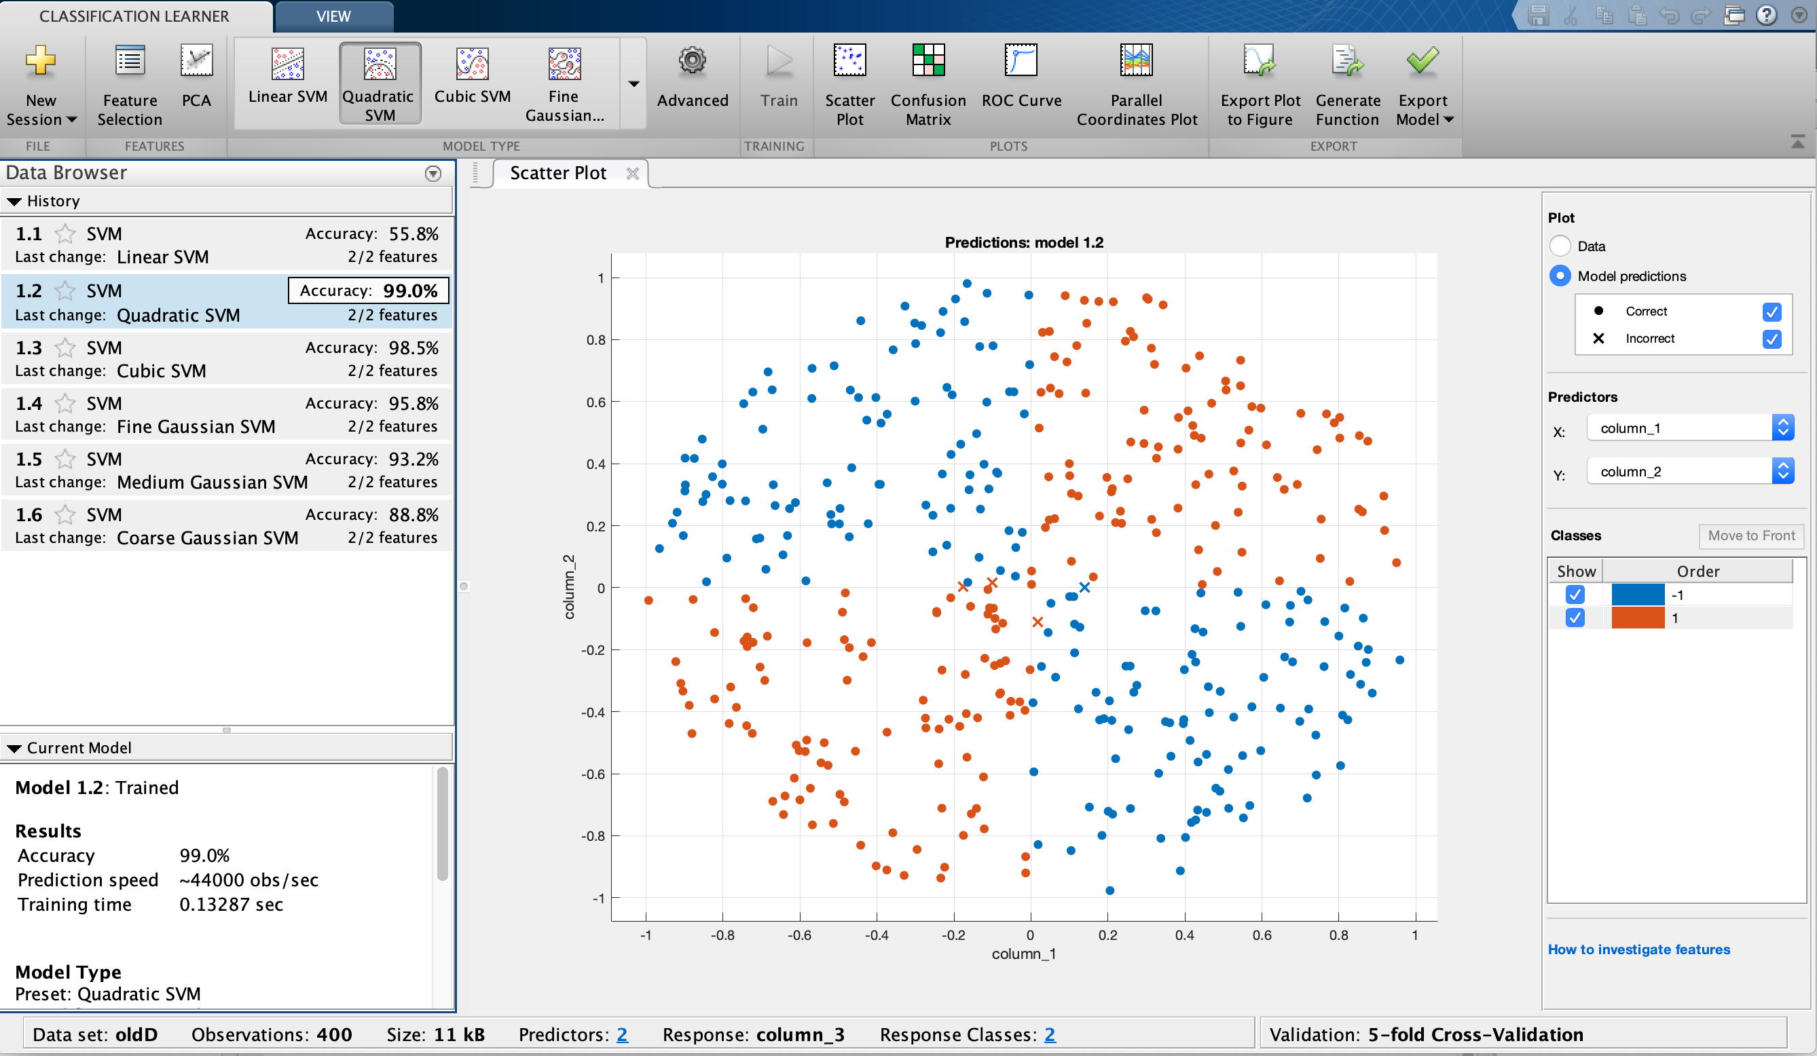
Training Accuracy 99%

Slide 5
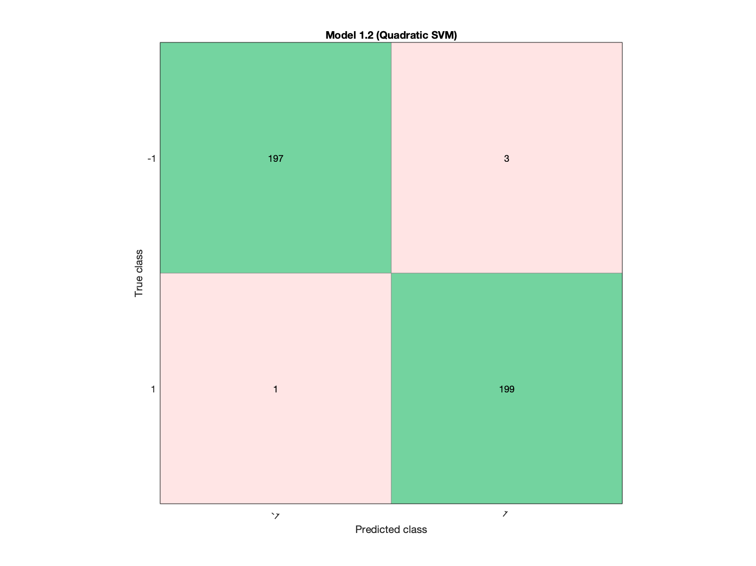
Training confusion matrix

Slide 6
Prediction
The output gives the confusion matrix of :
200 0
3 197
Which means the prediction is pretty good because we only have 3 wrong predictions.

Slide 7
Problem 2
Write matlab code that transforms the ratings into two labels:
1 for all classes except ‘CCC’
-1 for ‘CCC’
You will be issued a personal number between 1 and 45 (your number in the class list).

Slide 8
Problem2 Part1
Create a random subsample of 300 observations with label 1 and merge them with all the 130 observations with label -1. Use the random number generator seed =your personal number +300. You will have a sample with 430 observations. Do full SVM training for it, including accuracy and confusion matrix (with 5-fold cross validation).

Slide 9
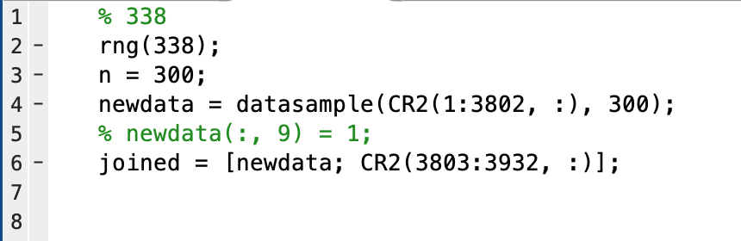
Given a number of 38
Import data CR2

Slide 10
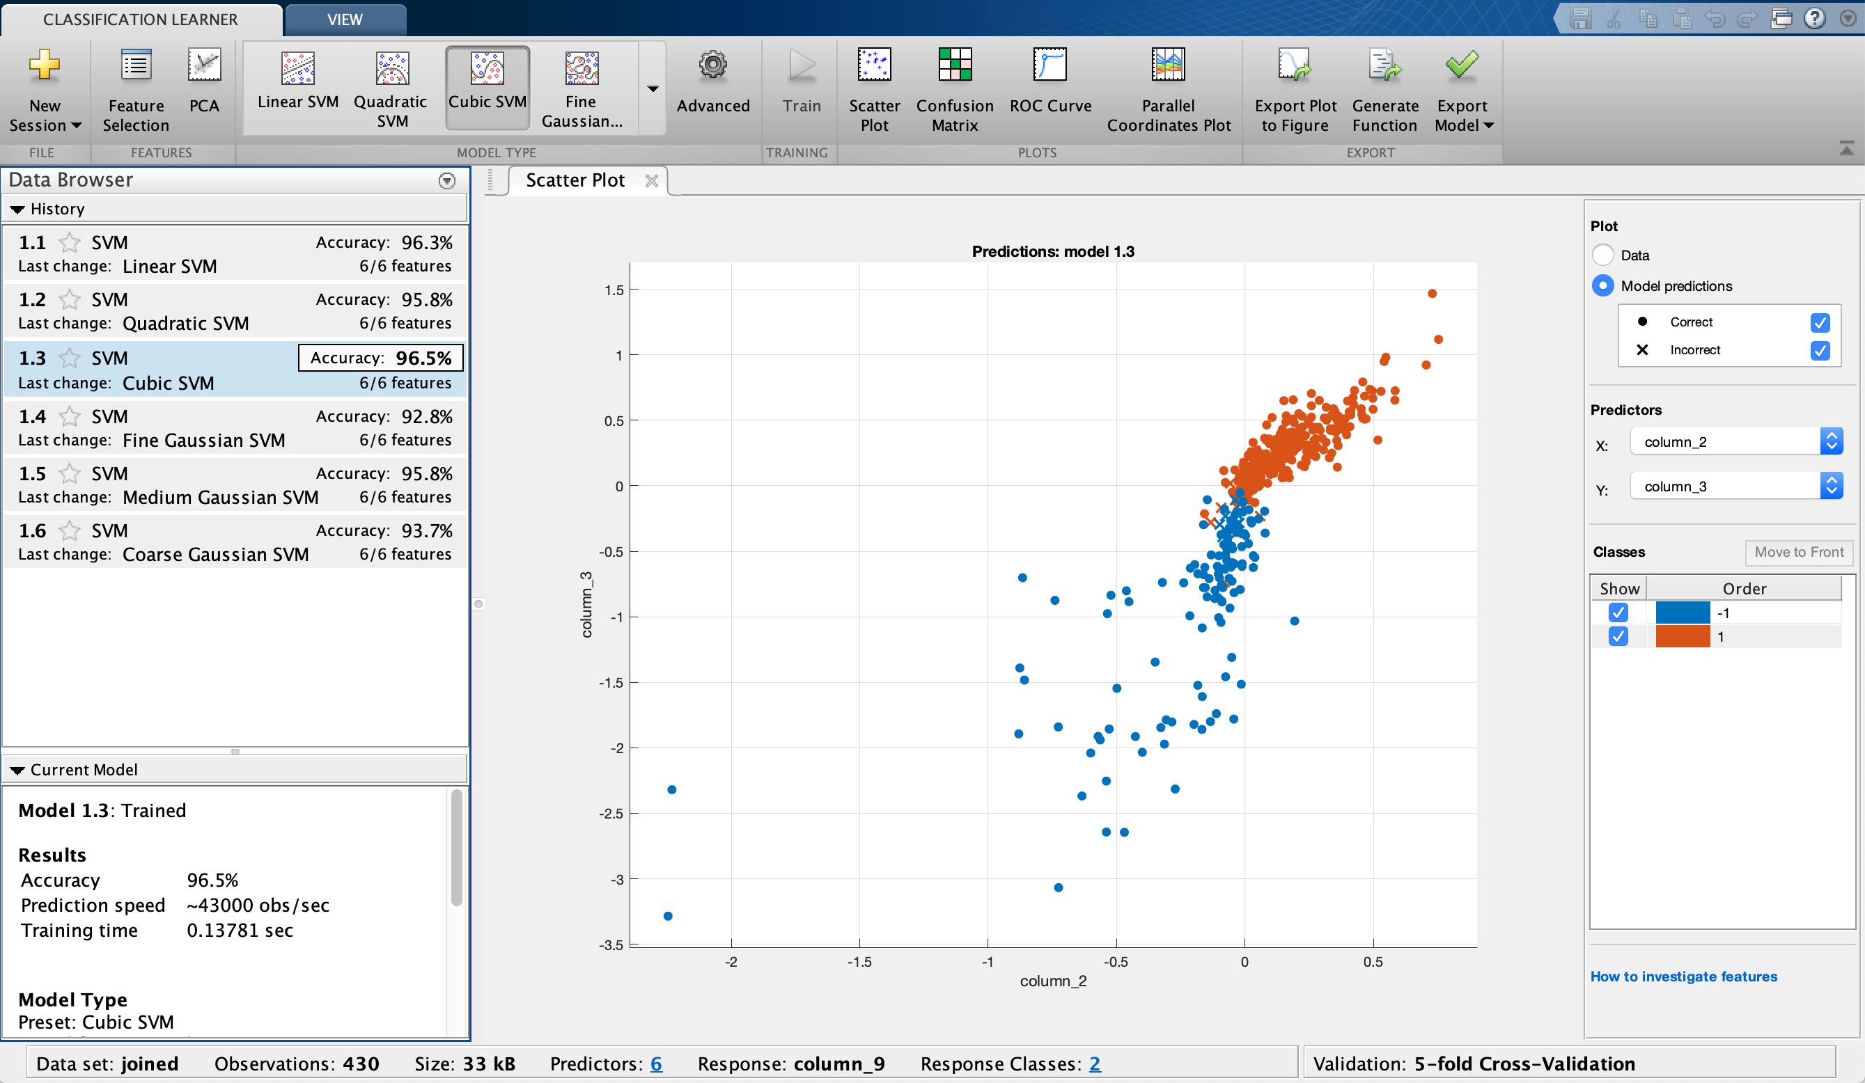
Training Accuracy 96.5%

Slide 11
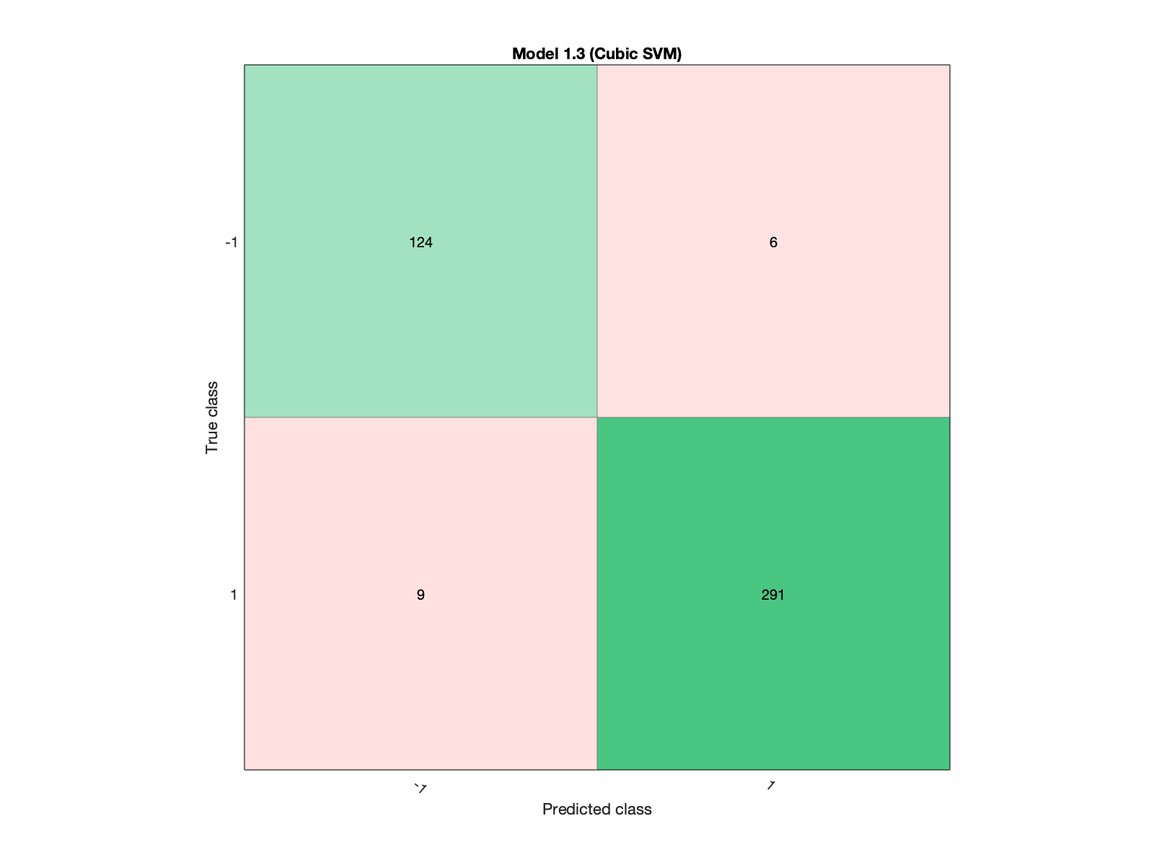
Training Confusion Matrix

Slide 12
Problem2 Part2
Create another random subsample of randomly selected 400 observations with label 1. Use the random number generator seed =your personal number +400. Do out-of-sample testing for it, including accuracy and confusion matrix.

Slide 13
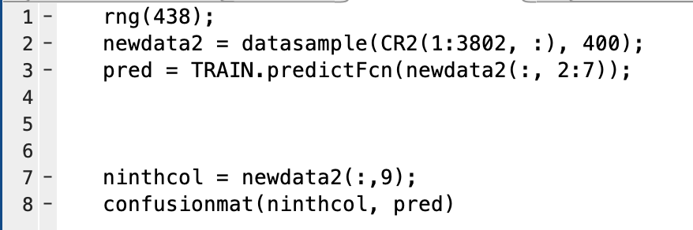
Prediction

Slide 14
Prediction
The output of the prediction confusion matrix is :
0 0
15 385
Which means the prediction is pretty good because we only have 15 wrong predictions.

